Slide 1

- Based on experience

Slide 2
MISSION
To help talented and ambitious Danish technology companies succeed on the North American market
Build strong BI solutions around your existing ERP solution
  To improve your solution stack
  Grow your business
  Improve your strategic impact at your customers
Notes:
FM

Slide 3
ABOUT US
Flemming Groenbaek Madsen
IT & SW Professional Since 1991
+10 years experience managing International Distributors and Global Sales
Independent Management Consultant since 2014
Experience as VP of Sales, Sales Executive, General Management
Located in Hjoerring, DK
Ulrik Pedersen
IT & SW Professional since 1999
Penetrated and built US company in 2005
Permanently in the US since 2005
Experience as CEO, COO, CTO, VP, Sales Executive
Located in Tampa Bay, FL, USA
Notes:
FM/UP

Slide 4
HOW USA READY ARE YOU?
Do you have a North American presence today?
  Customers already?
  Any US sales efforts made already?
Is your marketing material and documentation in general in (American) English?
Do you have any leads coming in from the US today?
How do you manage a sales process in the US today?
Do you have an American dream?
Notes:
FM

Slide 5
DO WE HAVE TO BE THERE?
Have you heard these statements before? ☺
We can work from anywhere as long as we have a high-speed internet connection!
It doesn’t matter where our customers are – we do everything remotely anyway!
We have sold many solutions without ever meeting the customers
Notes:
UP

Slide 6
DO WE HAVE TO BE THERE?
Reality is we are physical beings living in a virtual world
  You focus where you are!
  Have you noticed how the mind works when attending a US based conference for instance? And how it changes as soon as you clock into the Danish office again?
US corporations do not want to take on the risk of dealing with a foreign company
  Local presence and support a qualifier
Notes:
UP

Slide 7
WE HAVE DONE IT BEFORE
TARGIT’s Journey to the United States
  2001 1st attempt
  2003 2nd attempt
  2005 3rd attempt
  Tasklet Factory’s Journey to the United States
  2013 1st attempt
  2018 2nd attempt
  You do not have to make (all) the same mistakes we already paid for!
Notes:
FM

Slide 8
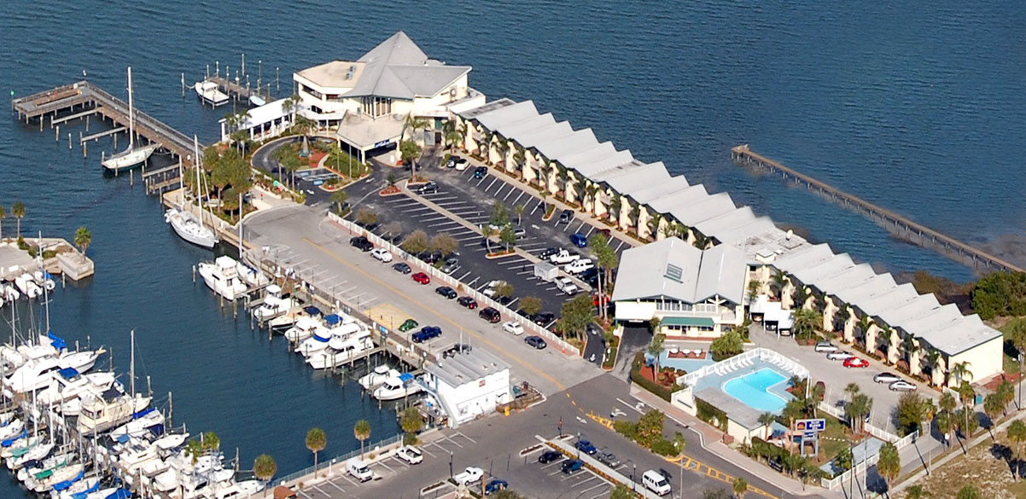
WORKSHOP VENUE
Yacht Harbor Inn, Marine & Restaurant, Dunedin, FL
Notes:
FM

Slide 9
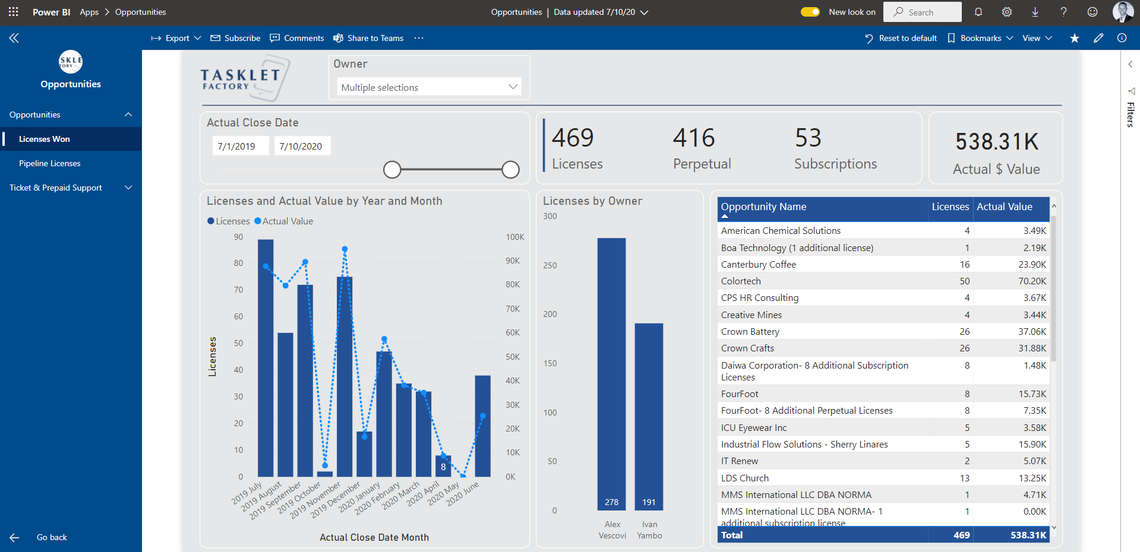
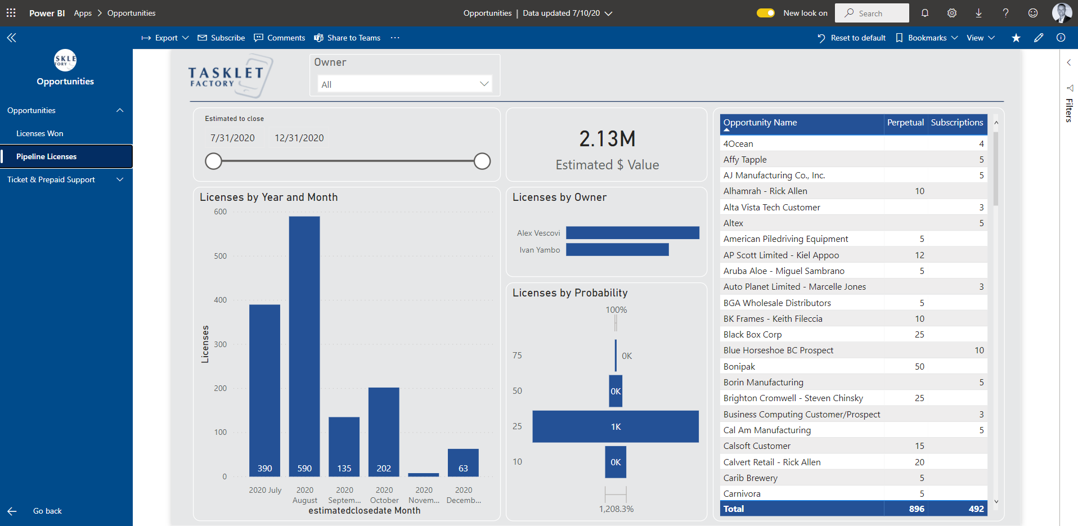
BI SAMPLE SOLUTION: 1
Internal Sales Dashboards
Pure PBI model
No DWH
MS CRM is the datasource
Multiple updates per day
Automated emails daily
Cloud and Mobile Device access
Notes:
FM

Slide 10
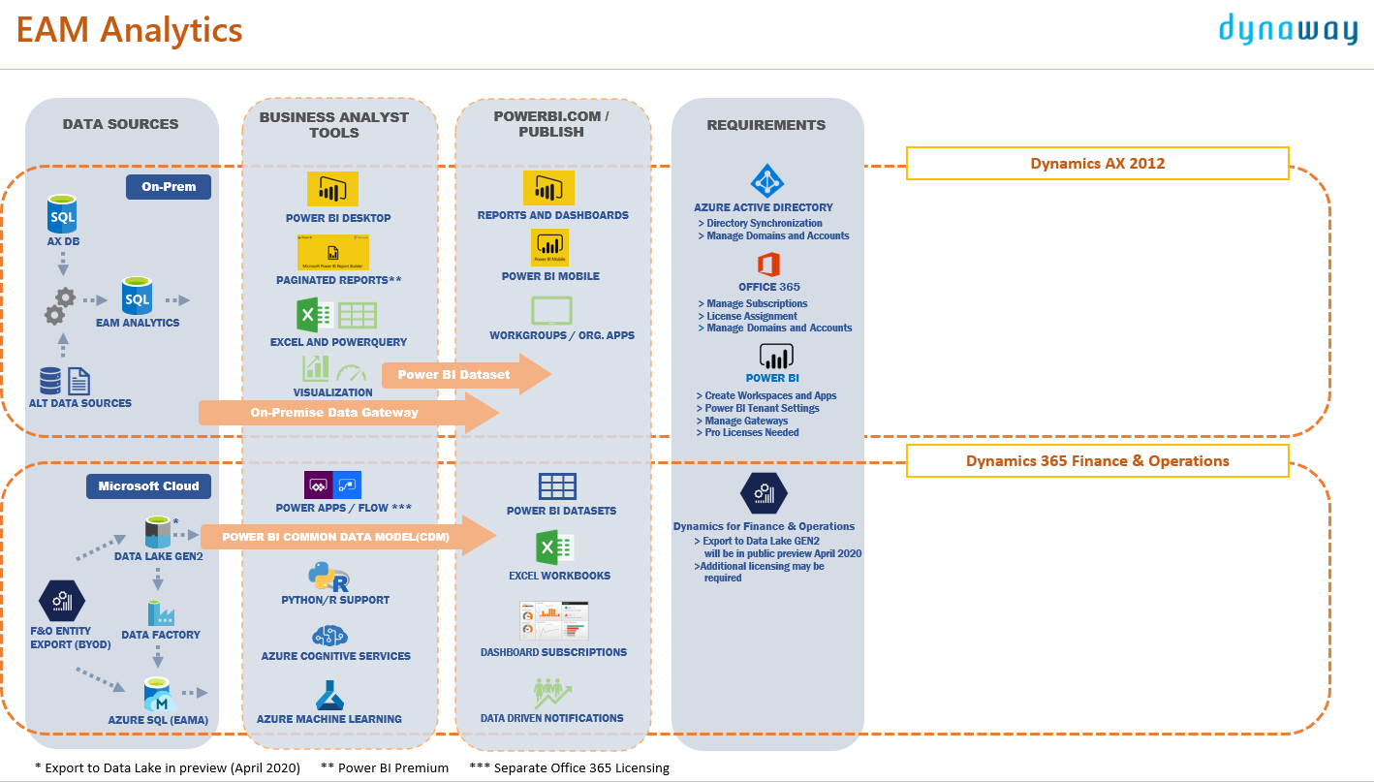
BI SAMPLE SOLUTION: 2 & 3
End-user BI Product
Compatible across multiple platforms and SW versions
True DWH solution (on-prem or Azure)
Seamless deployment models
Yet fully customizable
Desktop, Cloud and Mobile Device access
Notes:
FM

Slide 11
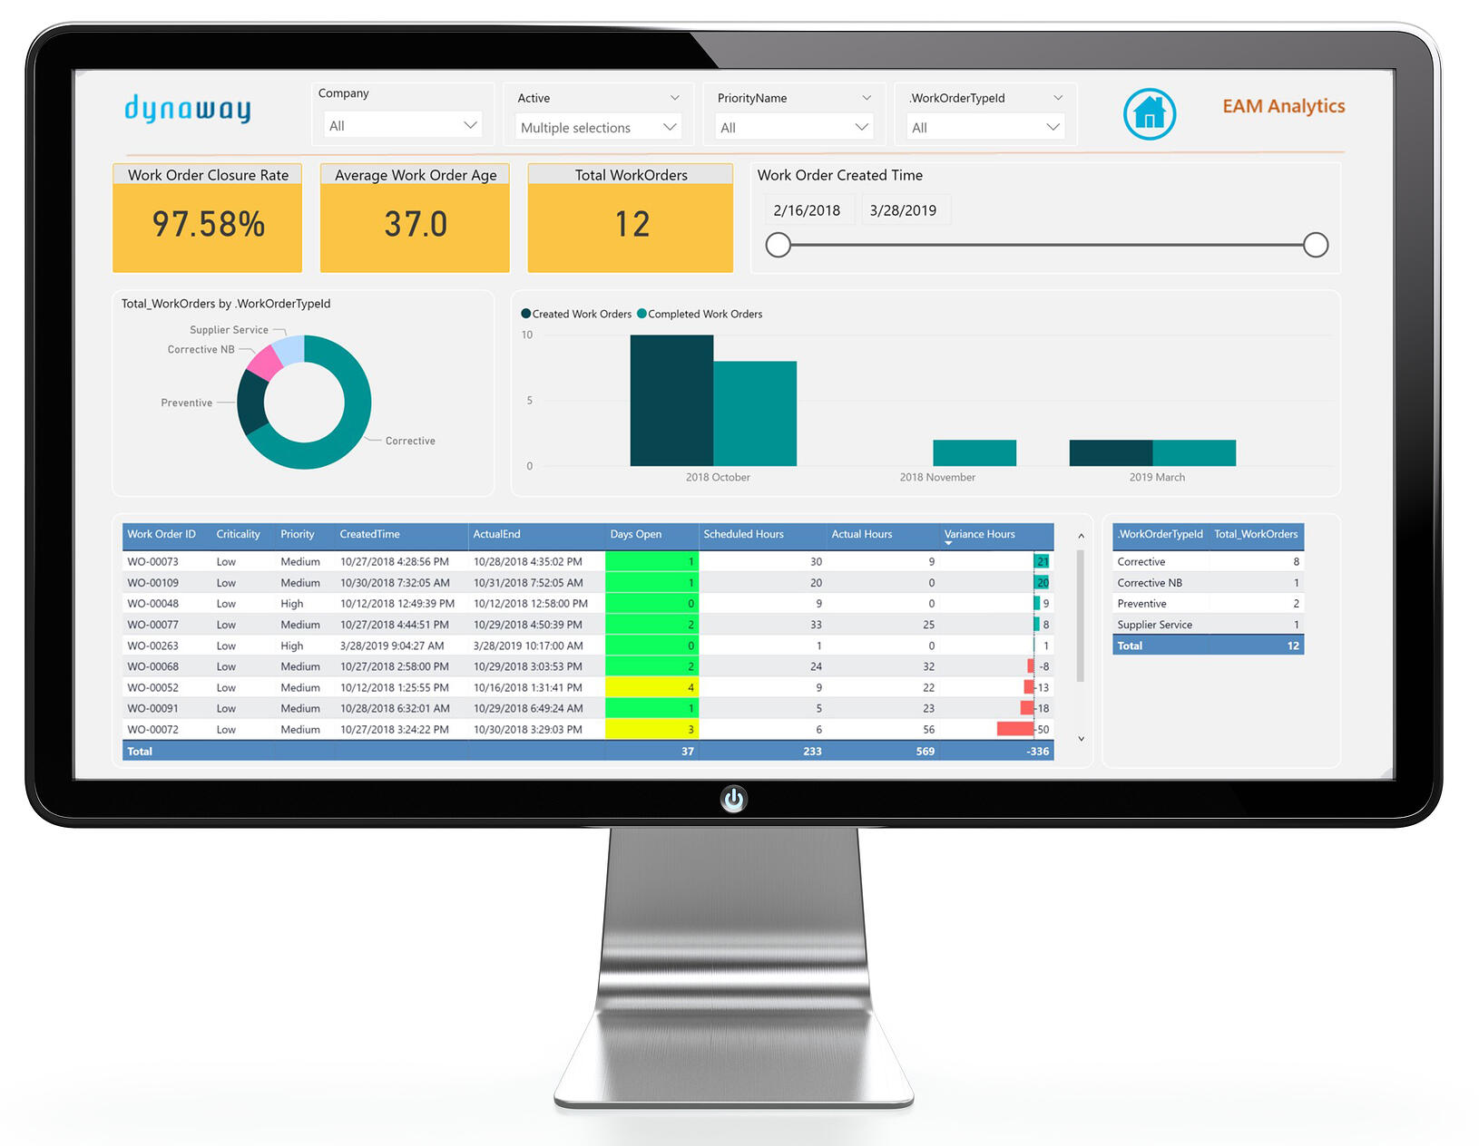
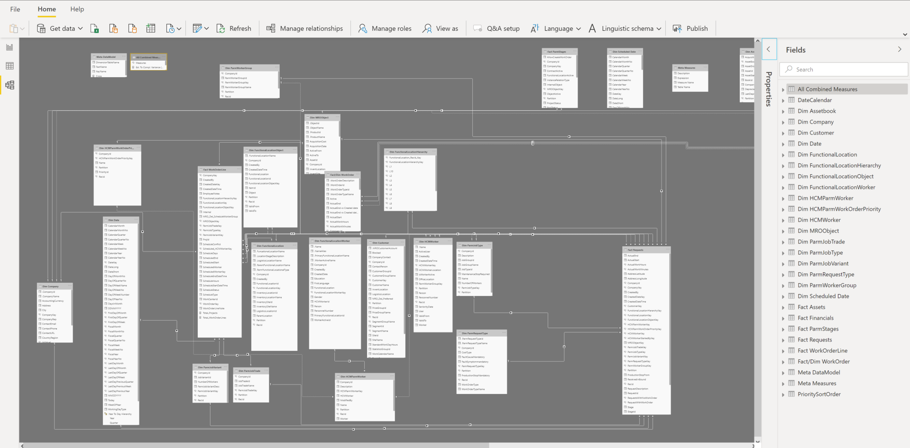
BI SAMPLE SOLUTION: 2 & 3
Notes:
FM

Slide 12

POTENTIAL SOLUTIONS FOR YOUR BUSINESS?
Notes:
FM

